Slide 1

Module 1: Introduction to Artificial Intelligence and Knowledge based Systems
Course Title & Code: Principles of Artificial Intelligence/CSE 228
Semester: B.Tech
Department of Computer Science & Engineering,
School of Engineering, Presidency University,
Bengaluru

Slide 2
Contents
Artificial Intelligence
What is AI ?
Foundations of Artificial Intelligence
History of Artificial Intelligence
Applications of AI
Agents
Agents: definition, structure and types
Different Agent Types relation with environment
Definition and Importance of Knowledge
Knowledge-Based Systems
Representation of Knowledge
Knowledge Organization
Semantic Network
Frame Structures
Conceptual graphs

Slide 3
Introduction to Artificial Intelligence, Definitions, foundation, History and Applications

Slide 4
Introduction to Artificial Intelligence
Homo Sapiens : The name is Latin for "wise man“
Philosophy of AI - “Can a machine think and behave like humans do?”
In Simple Words - Artificial Intelligence is a way of making a computer, a computer-controlled robot, or a software think intelligently, in the similar manner the intelligent humans think.
Artificial intelligence (AI) is an area of computer science that emphasizes the creation of intelligent machines that work and react like humans.
AI is accomplished by studying how human brain thinks, and how humans learn, decide, and work while trying to solve a problem, and then using the outcomes of this study as a basis of developing intelligent software and systems.

Slide 5
What is AI?
Views of AI fall into four categories:
Thinking humanly
Thinking rationally
Acting humanly
Acting rationally
The textbook advocates "acting rationally"

Slide 6
What is AI?
Thinking Humanly “The exciting new effort to make computers think … machines with minds, in the full and literal sense.” “Activities that we associate with human thinking, activities such as decision-making, problem solving, learning…” | Thinking Rationally “The study of mental faculties through the use of computational models.” “The study of the computations that make it possible to perceive, reason and act.”
Acting Humanly “The art of creating machines that perform functions that require intelligence when performed by people.” “The study of how to make computers do things at which, at the moment, people are better.” | Acting Rationally “Computational Intelligence is the study of the design of intelligent agents.” “AI … is concerned with intelligent behavior in artifacts.”

Slide 7
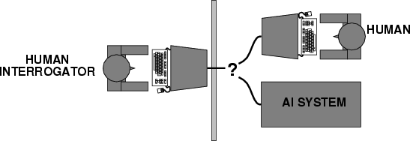
Acting humanly: Turing Test
Turing (1950) developed "Computing machinery and intelligence":
"Can machines think?" → "Can machines behave intelligently?"
Operational test for intelligent behavior: the Imitation Game
A computer passes the test if a human interrogator, after posing some written questions, cannot tell whether the written responses come from a person or from a machine.
Suggested major components of AI: knowledge, reasoning, language understanding, learning

Slide 8
Acting humanly: Turing Test
The computer would need to posses the following capabilities:
Natural Language Processing:
To enable it to communicate successfully in English.
Knowledge representation:
To store what it knows or hear.
Automated reasoning:
To use the stored information to answer questions and to draw new conclusions.
Computer vision:
To perceive objects.
Robotics:
To manipulate objects and move about.

Slide 9
Thinking humanly: Cognitive Modeling
If we are going to say that given program thinks like a human, we must have some way of determining how humans think.
We need to get inside the actual working of human minds.
There are 3 ways to do it:
Through introspection
Trying to catch our own thoughts as they go
Through psychological experiments
Observing a person in action
Through brain imaging Observing the brain in action

Slide 10
Thinking humanly: Cognitive Modeling
Once we have a sufficiently precise theory of the mind, it becomes possible to express the theory as a computer program.
If the program’s input-output behavior matches corresponding human behavior, that is evidence that the program’s mechanisms could also be working in humans

Slide 11
Thinking Rationally: “Laws of Thought"
Aristotle: one of the first to attempt to codify “right thinking”. Mathematical representation.
His syllogisms provided patterns for argument structures that always yielded correct conclusions when given premises are correct.
Example – Socrates is a man
All men are mortal
Therefore
Socrates is mortal

Slide 12
Acting Rationally: Rational Agent
An agent is an entity that perceives and acts
A system is rational if it does the “right thing,” given what it knows.
This course is about designing rational agents
Rational agent is one that acts so as to achieve the best outcome or, when there is uncertainty, the best expected outcome.
Abstractly, an agent is a function from percept histories to actions:
[f: P* → A]

Slide 13
Behave Rationally……….
What means “behave rationally” for a person/system:
Take the right/ best action to achieve the goals, based on his/its knowledge and belief
Example: Assume I don’t like to get wet in rain (my goal), so I bring an umbrella (my action). Do I
behave rationally?
The answer is dependent on my knowledge and belief
If I’ve heard the forecast for rain and I believe it, then bringing the umbrella is rational.
If I’ve not heard the forecast for rain and I do not believe that it is going to rain, then bringing the umbrella is not rational
“Behave rationally” does not always achieve the goals successfully
Example:
My goals – (i) do not get wet if rain; (ii) do not looked stupid (such as bring an umbrella when not raining)
My knowledge/belief – weather forecast for rain and I believe it
My rational behaviour – bring an umbrella
The outcome of my behaviour: If rain, then my rational behaviour achieves both goals; If no rain, then my rational behaviour fails to achieve the 2nd goal
The successfulness of “behave rationally” is limited by my knowledge and belief

Slide 14
Definition of AI
Existing definitions advocate everything from replicating human intelligence to simply solving knowledge-intensive tasks.
Examples:
“Artificial Intelligence is the design, study and construction of computer programs that behave intelligently.” -- Tom Dean.
“Artificial Intelligence is the enterprise of constructing a physical symbol system that can reliably pass the Turing test.” -- Matt Ginsberg.

Slide 15
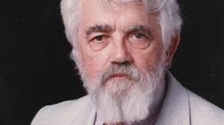
History of AI
1943
McCulloch & Pitts developed Boolean circuit model of brain
Turing's "Computing Machinery and Intelligence"
Dartmouth meeting: "Artificial Intelligence" adopted
1950
1956
1952—69
McCarthy referred “Look, Ma, no hands!” era People thought “Only arithmetic can be done and no more before 1952”. Astonishing if something is done remotely clever.
Early AI programs, including
» Samuel's checkers program,
» Newell & Simon's Logic Theorist : It was the first program deliberately engineered to mimic the problem solving skills of a human being and is called "the first artificial
intelligence program". It would eventually prove 38 of the first 52 theorems in Whitehead and Russell's Principia Mathematica
» Gelernter's Geometry Engine
Robinson's complete algorithm for logical reasoning
1950s
1965

Slide 16
AI Winter
Funding Reduces
P Vs NP
Exponential time and complexity explosions
Limited Computational Capabilities
RAM
Processing Power
Data
Moravec's paradox@ CMU
High-level reasoning requires very little computation, but low- level subconscious tasks require enormous computational resources
Notes:
Polynomial vs. Non-deterministic polynomial time

Slide 17
History of AI
AI discovers computational complexity Neural network research almost disappears
Early development of knowledge-based systems
AI becomes an industry
Neural networks return to popularity AI becomes a science
1966—73
1969—79
1980--
1986--
1987--
1995--
The emergence of intelligent agents

Slide 18
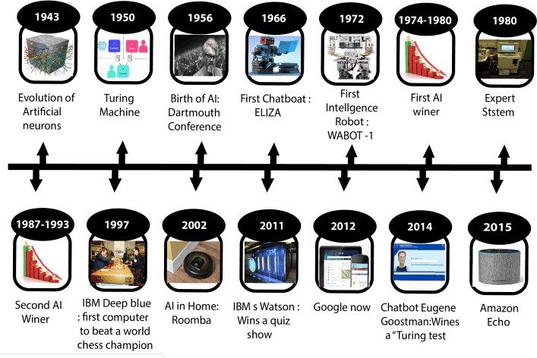
History of AI
Ref : https://www.javatpoint.com/history-of-artificial-intelligence

Slide 19
Foundations of Artificial Intelligence
Below are the disciplines that contributed ideas, viewpoints and techniques to AI:
Philosophy
Mathematics
Economics
Neuroscience
Psychology
Computer Engineering
Control theory
Linguistics

Slide 20
Foundations of Artificial Intelligence
Philosophy
Can formal rules be used to draw valid conclusions?
How does the mind arise from a physical brain? Where does knowledge come from?
How does knowledge lead to action?
Aristotle was the first to formulate a precise set of laws governing the rational part of the mind. He developed an informal system of syllogisms for proper reasoning, which in principle allowed one to generate conclusions mechanically, given initial premises.
All dogs are animals; all animals have four legs; therefore all dogs have
four legs
Descartes was a strong advocate of the power of reasoning in understanding the world, philosophy now called as rationalism.

Slide 21
Foundations of Artificial Intelligence
Mathematics
What are the formal rules to draw valid conclusions? What can be computed?
How do we reason with uncertain information?
Formal representation and proof algorithms: Propositional logic Computation: Turing tried to characterize exactly which functions are computable - capable of being computed.
(un)decidability: Incompleteness theory showed that in any formal theory, there are true statements that are undecidable i.e. they have no proof within the theory.
“ a line can be extended infinitely in both directions”
(in)tractability: A problem is called intractable if the time required to solve instances of the problem grows exponentially with the size of the instance. probability: Predicting the future.

Slide 22
Foundations of Artificial Intelligence
Economics
How should we make decisions so as to maximize payoff?
Economics is the study of how people make choices that lead to
preferred outcomes(utility).
Decision theory: It combines probability theory with utility theory, provides a formal and complete framework for decisions made under uncertainty.
Neuroscience
How do brains process information?
Neuroscience is the study of the nervous system, particularly brain.
Brain consists of nerve cells or neurons. 10^11 neurons.
Neurons are considered as Computational units.

Slide 23
Foundations of Artificial Intelligence
Psychology
How do Humans and animals think and act?
Computer engineering
How can we build an efficient computer?
Building fast computers
Control theory
How can artifacts operate under their own control?
Design systems that maximize an objective function over time
Linguistics
How does the language relate to thought?
knowledge representation, grammar

Slide 24
Applications of AI
Applications:
Deep Blue (chess-playing computer) defeated the world chess champion Garry Kasparov in 1997.
During the 1991 Gulf War, US forces deployed an AI logistics planning and scheduling program that involved up to 50,000 vehicles, cargo, and people
Planning – How to use resources? Scheduling – When to use the resources?
NASA's on-board autonomous planning program controlled the scheduling of operations for a spacecraft
Google duplex
The GPS developed in 1957 by Alan Newell and Hervert Simon, embodied a grandiose vision
Notes:
Google duplex is a AI chat agent that can carry out specific verbal tasks like making an appointment or reservation…it is built using a RNN and Tensorflow

Slide 25
Future Perspective
Reducing the time and cost of development is a big plan for AI.
To develop applications towards strong AI.
(3) Allowing students to work collaboratively is another plan from Researchers.
Perfect rationality: the classical notion of rationality in decision theory.
Bounded optimality: A bounded optimal agent behaves as well as possible given its computational resources.
Game theory studies decision problems in which the utility of a given action depends not only on chancing events in the environment but also on the actions of other agents.

Slide 26
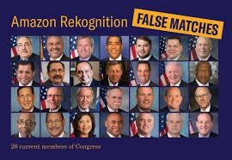


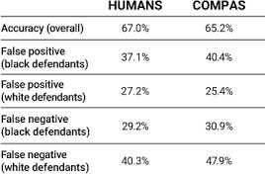
Major Concerns
TAY
COMPAS - Correctional Offender Management Profiling for Alternative Sanctions
Notes:
Tay was an AI chatter bot originally released by Microsoft via Twitter on March 23, 2016. It caused subsequent controversy when the bot began to post inflammatory and offensive tweets through its twitter account, forcing MS to shut down the service only 16 hrs after its launch
COMPAS is a case management and decision support tool developed and owned by Northpointe, used by U.S. courts to assess the likelihood of a defendant becoming a recidivist (recurring offender)

Slide 27
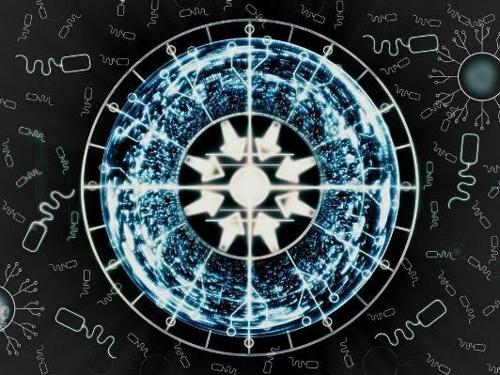

Singularity
Singularity is a hypothetical future point in time at which technological growth becomes uncontrollable and irreversible, resulting in unfathomable changes to human civilization

Slide 28
AGENTS

Slide 29
Agents in Artificial Intelligence
Artificial intelligence is defined as a study of rational agents. A rational agent could be anything which makes decisions, as a person, firm, machine, or software. It carries out an action with the best outcome after considering past and current percepts(agent’s perceptual inputs at a given instance). An AI system is composed of an agent and its environment. The agents act in their environment. The environment may contain other agents. An agent is anything that can be viewed as :
perceiving its environment through sensors and
acting upon that environment through actuators

Slide 30
The Structure of Intelligent Agents
Agent’s structure can be viewed as −
Agent = Architecture + Agent Program
Architecture = the machinery that an agent executes on.
Agent Program = an implementation of an agent function.

Slide 31
The Structure of Intelligent Agents
To understand the structure of Intelligent Agents, we should be familiar with Architecture and Agent Program. Architecture is the machinery that the agent executes on. It is a device with sensors and actuators, for example : a robotic car, a camera, a PC. Agent program is an implementation of an agent function. An agent function is a map from the percept sequence(history of all that an agent has perceived till date) to an action.

Slide 32
Agent Terminology
Performance Measure of Agent − It is the criteria, which determines how successful an agent is.
Behavior of Agent − It is the action that agent performs after any given sequence of percepts.
Percept − It is agent’s perceptual inputs at a given instance.
Percept Sequence − It is the history of all that an agent has perceived till date.
Agent Function − It is a map from the precept sequence to an action.

Slide 33
Rationality
Rationality is nothing but status of being reasonable, sensible, and having good sense of judgment.
Rationality is concerned with expected actions and results depending upon what the agent has perceived. Performing actions with the aim of obtaining useful information is an important part of rationality.
What is Ideal Rational Agent?
An ideal rational agent is the one, which is capable of doing expected actions to maximize its performance measure, on the basis of −
Its percept sequence
Its built-in knowledge base
Rationality of an agent depends on the following −
The performance measures, which determine the degree of success.
Agent’s Percept Sequence till now.
The agent’s prior knowledge about the environment.
The actions that the agent can carry out.
A rational agent always performs right action, where the right action means the action that causes the agent to be most successful in the given percept sequence. The problem the agent solves is characterized by Performance Measure, Environment, Actuators, and Sensors (PEAS).

Slide 34
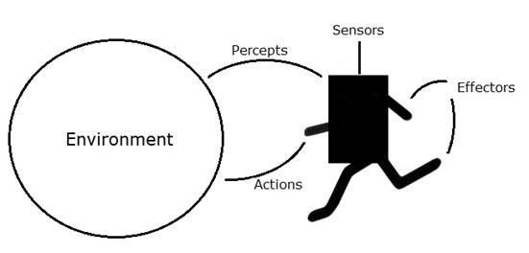
Examples of Agent:-
An agent is anything that can perceive its environment through sensors and acts upon that environment through effectors.
A human agent has sensory organs such as eyes, ears, nose, tongue and skin parallel to the sensors, and other organs such as hands, legs, mouth, for effectors.
A robotic agent replaces cameras and infrared range finders for the sensors, and various motors and actuators for effectors.
A software agent has encoded bit strings as its programs and actions.

Slide 35
Types of Agents
Agents can be grouped into five classes based on their degree of perceived intelligence and capability. All these agents can improve their performance and generate better action over the time. These are given below:
Simple Reflex Agent
Model-based reflex agent
Goal-based agents
Utility-based agent
Learning agent

Slide 36
Simplex Agent
The Simple reflex agents are the simplest agents. These agents take decisions on the basis of the current percepts and ignore the rest of the percept history.
These agents only succeed in the fully observable environment.
The Simple reflex agent does not consider any part of percepts history during their decision and action process.
The Simple reflex agent works on Condition-action rule, which means it maps the current state to action. Such as a Room Cleaner agent, it works only if there is dirt in the room.
Problems for the simple reflex agent design approach:
They have very limited intelligence
They do not have knowledge of non-perceptual parts of the current state
Mostly too big to generate and to store.
Not adaptive to changes in the environment.

Slide 37
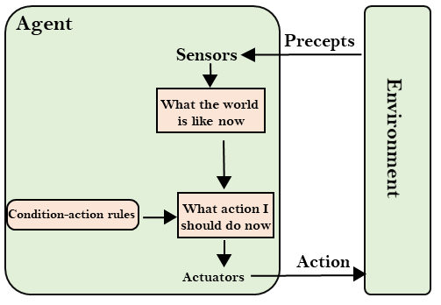
Simplex Agent

Slide 38
Model-based reflex agent
The Model-based agent can work in a partially observable environment, and track the situation.
A model-based agent has two important factors:
Model: It is knowledge about "how things happen in the world," so it is called a Model-based agent.
Internal State: It is a representation of the current state based on percept history.
These agents have the model, "which is knowledge of the world" and based on the model they perform actions.
Updating the agent state requires information about:
How the world evolves
How the agent's action affects the world.

Slide 39
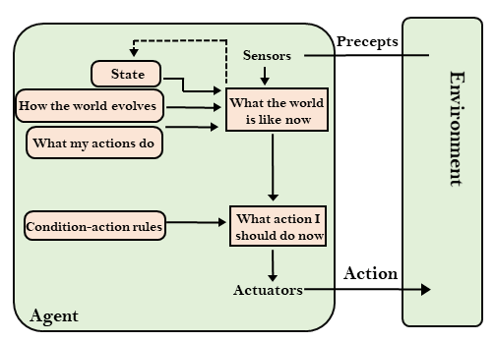
Model-based reflex agent

Slide 40
Goal-based agents
The knowledge of the current state environment is not always sufficient to decide for an agent to what to do.
The agent needs to know its goal which describes desirable situations.
Goal-based agents expand the capabilities of the model-based agent by having the "goal" information.
They choose an action, so that they can achieve the goal.
These agents may have to consider a long sequence of possible actions before deciding whether the goal is achieved or not. Such considerations of different scenario are called searching and planning, which makes an agent proactive.

Slide 41
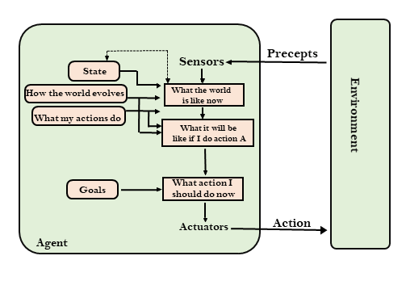
Goal-based agents

Slide 42
Utility-based agents
These agents are similar to the goal-based agent but provide an extra component of utility measurement which makes them different by providing a measure of success at a given state.
Utility-based agent act based not only goals but also the best way to achieve the goal.
The Utility-based agent is useful when there are multiple possible alternatives, and an agent has to choose in order to perform the best action.
The utility function maps each state to a real number to check how efficiently each action achieves the goals.

Slide 43
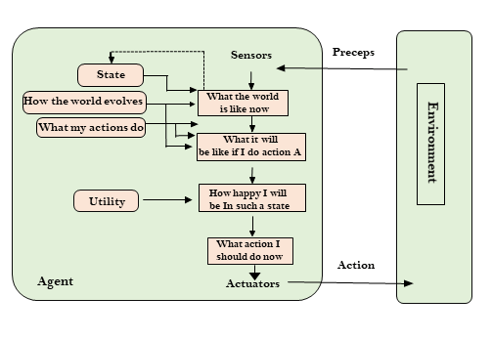
Utility-based agents

Slide 44
Learning Agents
A learning agent in AI is the type of agent which can learn from its past experiences, or it has learning capabilities.
It starts to act with basic knowledge and then able to act and adapt automatically through learning.
A learning agent has mainly four conceptual components, which are:
Learning element: It is responsible for making improvements by learning from environment
Critic: Learning element takes feedback from critic which describes that how well the agent is doing with respect to a fixed performance standard.
Performance element: It is responsible for selecting external action
Problem generator: This component is responsible for suggesting actions that will lead to new and informative experiences.
Hence, learning agents are able to learn, analyze performance, and look for new ways to improve the performance.

Slide 45
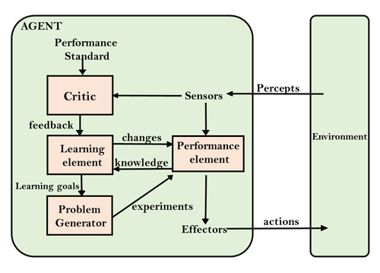
Learning Agents

Slide 46
KNOWLEDGE

Slide 47
Knowledge
Definition and Importance of Knowledge
Knowledge-Based Systems
Knowledge Organization
Representation of Knowledge
Logic
Associative Networks
Frame Structures
Conceptual graphs

Slide 48
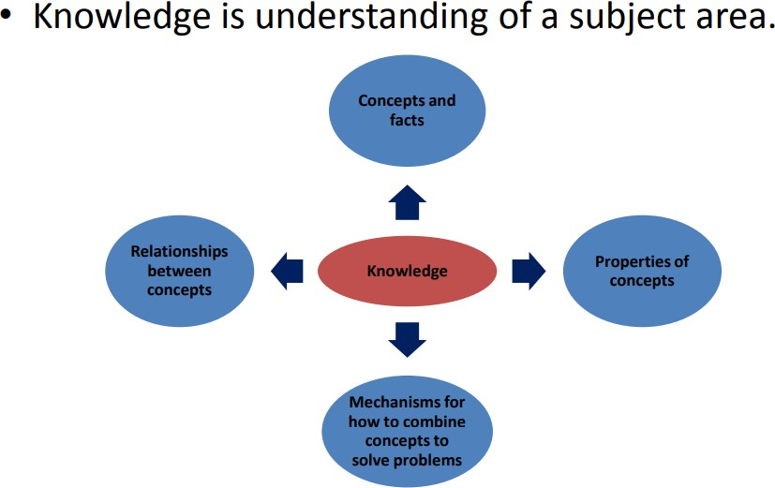
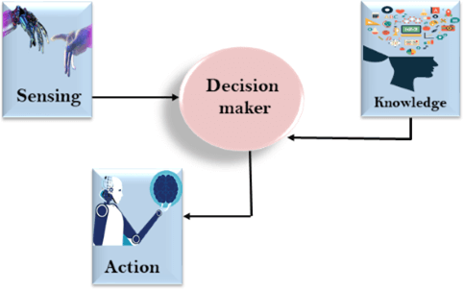
What is Knowledge ?
Knowledge is the sort of information that people use to solve problems.
Knowledge is having familiarity with the language, concepts, procedures, rules, ideas, places, customs, facts, and associations.
Ref : https://nptel.ac.in/courses/126104006/LectureNotes/Week-3_Knowledge%20Representation.pdf https://www.javatpoint.com/knowledge-representation-in-ai

Slide 49
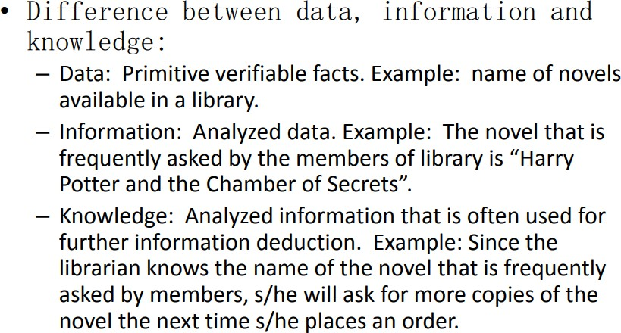
What is Knowledge?
Ref : https://nptel.ac.in/courses/126104006/LectureNotes/Week-3_Knowledge%20Representation.pdf

Slide 50
Importance of Knowledge
Knowledge is Power
Knowledge is the primary factor that distinguishes the
human race from animals
knowledge is even what prevents us from making the same mistakes we made in the past.
With knowledge, one can improve their abilities of
thinking critically
To make program intelligent provide it with lots of high quality specific knowledge about some problem area.
AI systems are divided into a Knowledge Base with facts about the world and rules and an inference engine that applies the rules to the knowledge base in order to answer questions and solve problems.

Slide 51
Importance of Knowledge
Common way to represent knowledge is in the form of
written language.
For example, some facts and relations represented in English are:
Joe is tall.
Bill likes Sue.
Sam has learned to use recursion to manipulate
linked list in several programming languages.

Slide 52
Importance of Knowledge
Joe is tall.
knowledge above expresses simple fact.
an attribute possessed by a person.
Bill likes Sue.
knowledge above expresses complex binary relation between two persons.
Sam has learnt to use recursion to manipulate linked list in several programming languages.
knowledge above is the most complex.
Expressing relations between a person and more abstract programming concepts.

Slide 53
Important points on Knowledge
Knowledge may be declarative or procedural
Procedural Knowledge
- It is a compiled knowledge related to the performance of some task.
For example, the steps used to solve an algebraic equations are expressed as procedural knowledge.
Declarative Knowledge
- Passive knowledge expressed as statements of facts about the world.
For example, personnel data in a database.

Slide 54
Important points on Knowledge Knowledge should not be confused with data
Example:
A physician treating a patient uses both knowledge and data.
Data: Patient’s record, including patient history, drugs given, responses to drugs, and so on.
Knowledge: What the physician has learnt in medical school and in the years of internship, specialization and practice.
It consists of facts, prejudices and beliefs.

Slide 55
Important points on Knowledge
Knowledge includes and requires the use of data and information.
It combines relationships, correlations and dependencies.

Slide 56
Important points on Knowledge
Distinction between Knowledge and other concepts such as belief and hypotheses
Belief: Any meaningful and coherent expression that can be represented. It may be true or false.
E.g. It is not good to have lunch after 4.30.
Hypotheses: A Justified belief that is not known to be true.
E.g. Tomorrow guests are coming; so prepare Fried Rice for lunch. They may like it.
Knowledge: True justified belief.
E.g. If you want to get better marks, you need to practice more. By practicing more, you can remember the concepts.

Slide 57
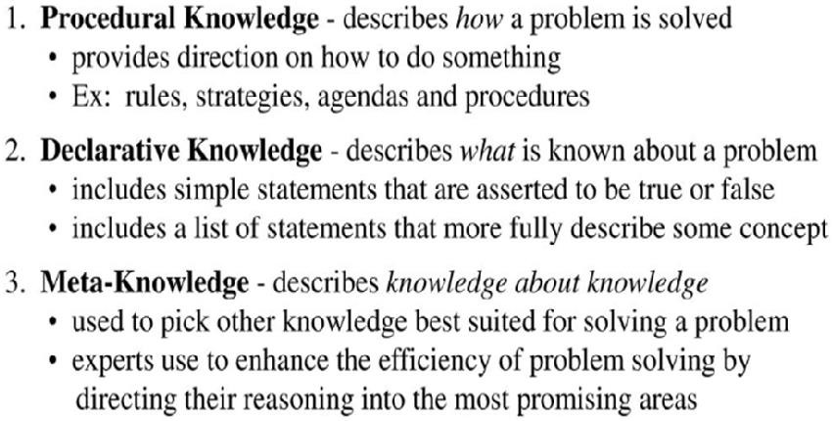
Types Of Knowledge

Slide 58
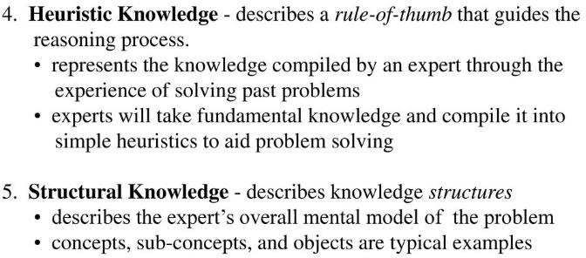
Types Of Knowledge

Slide 59
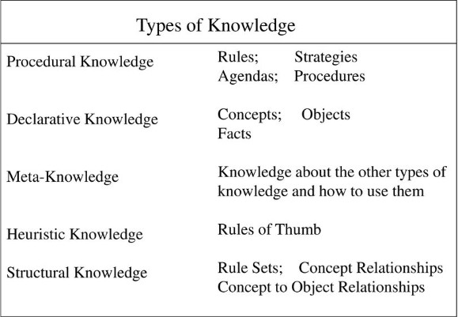

Slide 60
Knowledge Based Systems (KBS)
A knowledge-based system
(KBS) is
uses a
a computer knowledge
program that reasons and
base to solve complex problems
A system which is built around a knowledge base. i.e. a collection of knowledge, taken from a human, and stored in such a way that the system can reason with it
Uses AI to solve problems within a specialized domain that ordinarily requires human expertise
Uses Heuristic (cause and effect) rather than algorithms
E.g.
Expert Systems
Clinical decision-support systems
MYCIN, for example, was an early knowledge-based system created to help
doctors diagnose diseases

Slide 61
KBS Examples
Expert Systems
One in which the knowledge, stored in the knowledge base, has been taken from an expert in some particular field
Expert systems are designed to solve complex problems by reasoning through bodies of knowledge, represented mainly as if–then rules rather than through conventional procedural code
Therefore, an expert system can, to a certain extent, act as a substitute for the expert from whom the knowledge was taken
Clinical decision-support systems
MYCIN, for example, was an early knowledge-based system
created to help doctors diagnose diseases

Slide 62
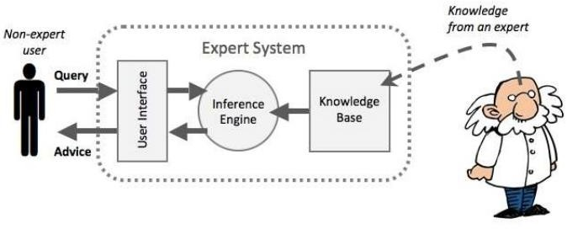
KBS Architecture
https://www.researchgate.net/figure/Expert-System-Architecture-23-Knowledge-Base_fig1_319208444

Slide 63
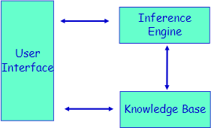
KBS Architecture
User Interface
– Enables the user to communicate with KBS

Slide 64
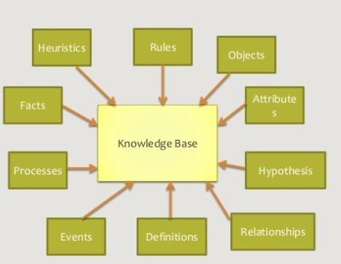
KBS Architecture
KBS = Knowledge-Base + Inference Engine
Knowledge Base
– The component of KBS that the
contains system’s knowledge organized
in
collection of facts about the system’s domain

Slide 65
Knowledge base System
Storing knowledge inside the program
#include<stdio.h> int main()
{
char dob=“20/08/1992”;
………….
………….
#Knowledge
}
Instead write the dob in text file and access the date of birth from the text file
20/08/1992
Text file: dob.txt

Slide 66
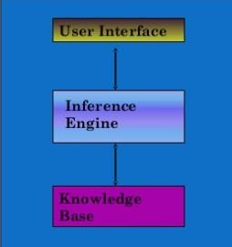
KBS Architecture
Inference Engine :
Tries to derive answers from knowledge base
Brain of KBS that provides a methodology for reasoning about the information in the knowledge base and for formulating conclusions

Slide 67
Example 1 for AI system: Gender Identification Problem
Male and female names have some distinctive characteristics.
Names ending in a, e and i are likely to be female.
Names ending in k, n, r, s and t are likely to be male.
Input File: male.txt
Amit Prasan Ashok Ankit Amar Chetan Shashank Sumant
Input File: female.txt
Reshma Akshata Vani Sita Bhavani Lalita Ankita Harika
Output: Predict the Gender for the following names:
Karan
Sameera

Slide 68
Architecture of AI Components of Knowledge base System
Input – Output
Unit
Inference- control Unit
Knowledge
base
Input-output: male.txt and female.txt
Knowledge base:
From the last character in the name identification of gender is
possible.
Inference-control Unit: AI Algorithm Implementation – Programs Example: Naïve Bayes Algorithm, Decision Tree Algorithm

Slide 69
List of Common Algorithms:
Naive Bayes
Decision Trees
Linear Regression
Support Vector Machines (SVM)
Neural Networks

Slide 70
Example 2 for AI system: Movie Rating
Airlift Movie rating – Reviews (Movie site, Facebook, Blog)
Post - How is Airlift Movie?
Comments from the people who watched movie -
Airlift Movie is nice.
It’s boring.
Yesterday I went to the movie. I enjoyed it.
Superb.

Slide 71
Architecture of AI Components of Knowledge base System
Input – Output
Unit
Inference- control Unit
Knowledge
base
Input-output: Facebook, twitter and movie site comments about the movie.
Knowledge base: Contains the positive, negative and neutral keywords
(Dictionary).
Inference-control Unit: AI Algorithm Implementation – Programs
Example: NLP Algorithms, Naïve Bayes Algorithm, Support Vector Machines

Slide 72
Architecture of AI Components of Knowledge base System
Input – Output
Unit
Inference- control Unit
Knowledge
base
Knowledge-based systems – get the power from expert knowledge that has been coded into facts, heuristics, and procedures.
The knowledge is stored in knowledge base separate from the
control and inference components.
This makes possible to add new knowledge or refine existing knowledge without recompiling the control and inference programs.

Slide 73
KBS architecture (1)
The typical architecture of an KBS is often described as follows:
user
interface
inference engine
knowledge base

Slide 74
KBS architecture (2)
However, it is reasonable to produce a richer, more elaborate, description of the typical KBS.
A more elaborate description, which still includes the components that are to be found in almost any real-world system, would look like this:

Slide 75
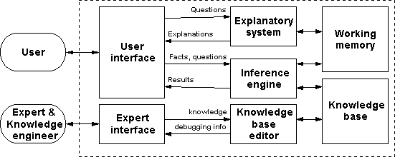
KBS architecture (2)

Slide 76
KBS architecture (2)
The system holds a collection of general principles which can potentially be applied to any problem - these are stored in the knowledge base.
The system also holds a collection of specific details that apply to the current problem (including details of how the current reasoning process is progressing) - these are held in working memory.
Both these sorts of information are processed by the inference engine.

Slide 77
KBS architecture (2)
Expert System: This artificial intelligence system is a database which attempts to reason like a person by using logic to extract new information from a set of information.
Any practical expert system needs an explanatory facility. It is essential that an expert system should be able to explain its reasoning. This is because:
it gives the user confidence in the system;
it makes it easier to debug the system.

Slide 78
KBS architecture (2)
It is not unreasonable to include an expert interface & a knowledge base editor, since
any practical KBS is going
mechanism for efficiently
to need a
building and
modifying the knowledge base.

Slide 79

Knowledge Organization
Knowledge involves
organization
activities
that
index, and
for and
"classify, categorize
map,
knowledge storage,
navigation, retrieval“

Slide 80
Knowledge Organization
Organization of knowledge in memory is key to
efficient processing.
Knowledge-based systems may require tens of thousands of facts and rules to perform their intended tasks.
It is essential that appropriate facts and rules be easy to locate and retrieve.
Otherwise, much time will be wasted in searching and testing large number of items in the memory.

Slide 81
Knowledge Organization
Knowledge can be organized in memory for easy access by a method known as indexing.
It amounts to grouping the knowledge in a way that keywords can be used to access the group.
Example:
Positive: Nice Beautiful Superb
Negative: Bad Doubt Guilt

Slide 82
Dataset
A collection of related sets of information that is composed of separate elements but can be manipulated as a unit by a computer.
Input File: female.txt
Reshma Akshata Vani Sita Bhavani Lalita Ankita Harika

Slide 83
Dataset
Size of the dataset should be as large as possible, which increases the prediction accuracy.
Dataset should not contain duplicate elements.

Slide 84
Knowledge Manipulation
Knowledge manipulation involves the following activities:
Knowledge acquisition
It is the process of gathering, structuring and organizing knowledge of a particular topic or a domain in order to prepare it to be put into the computer memory.
Knowledge Storing
The process of putting the knowledge into the computer in a suitably encoded format.
Knowledge Retrieval
The inverse process of getting the knowledge back whenever it is needed.
Reasoning
This is the most important part of knowledge representation.
It includes deriving new knowledge from the existing knowledge by means of an intelligent program.
The newly derived knowledge is known as conclusion, inference or
explanation.

Slide 85
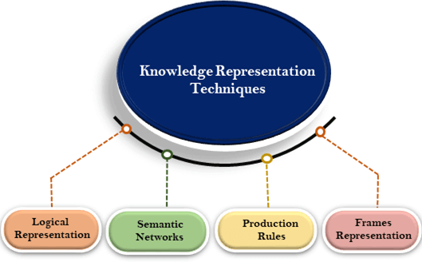
Knowledge Representation (KR)
The method used to encode knowledge in an KBS’s Knowledge base
The field of AI dedicated to representing information about the world in a
form that a computer system can utilize to solve complex tasks
https://www.javatpoint.com/ai-techniques-of-knowledge-representation

Slide 86
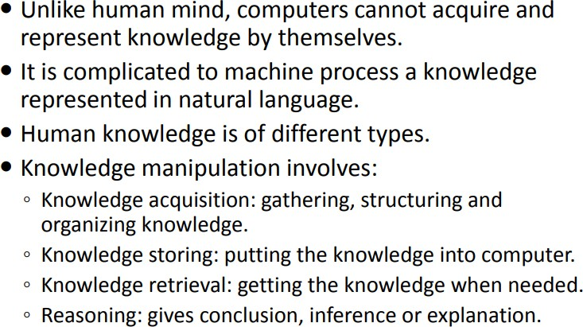
Why do we need Knowledge Representation?
Ref : https://nptel.ac.in/courses/126104006/LectureNotes/Week-3_Knowledge%20Representation.pdf

Slide 87
Knowledge Representation Schemas
Logical schemas - First-order logic - Higher-order logic | Network schemas - Semantic networks - Conceptual graphs
Procedural schemas - Rule-based systems | Structural schemas - Frames - Scripts

Slide 88
Common Techniques of KR
Object – Attribute – Value Triplets (O-A-V)
Rules
Semantic Networks
Frames
Logic

Slide 89
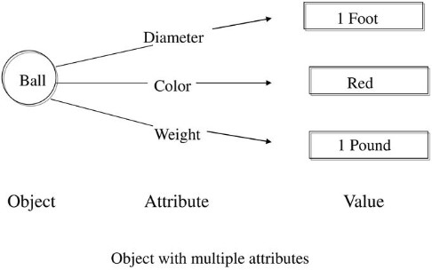
O-A-V
The Ball is round in shape
Object : Ball
Attribute : Shape
Value : Red

Slide 90
Rules
Rule: A knowledge structure that relates some known information to other information that can be concluded or inferred
A rule describes how to solve a problem
Expert systems employing rules are called rule-based expert systems

Slide 91
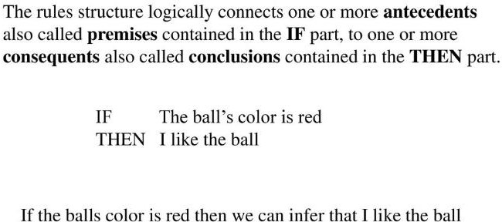
Structure of Rule

Slide 92
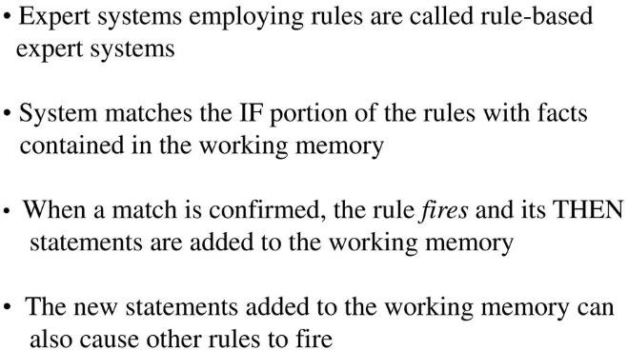
Working Memory

Slide 93
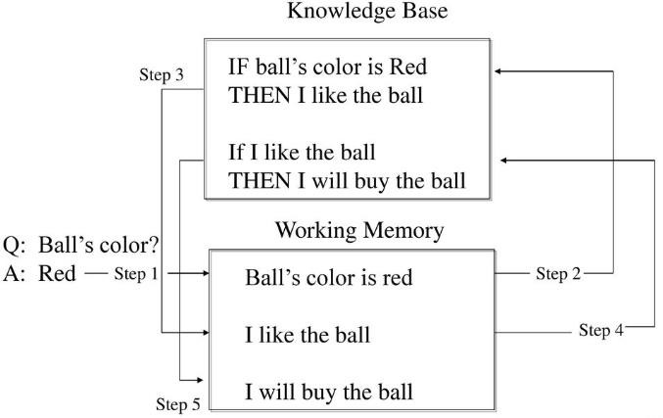
Inference Engine

Slide 94
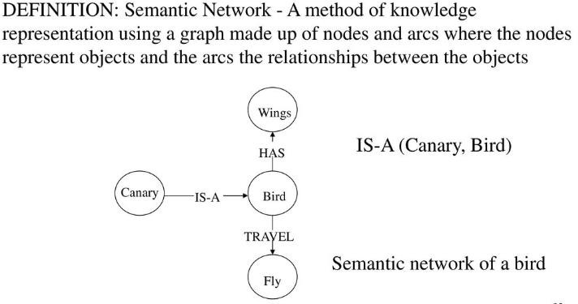
Semantic Networks

Slide 95
Associative Networks
Semantic networks consist of nodes, links (edges) and link labels.
nodes appear as circles or ellipses or rectangles to represent objects such as physical objects, concepts or situations.
Links appear as arrows to express the relationships between objects .
link labels specify particular relations .
As nodes are associated with other nodes semantic nets are also referred to as Associative Networks.
Semantic Networks, Frames and Scripts are sometimes called as Associative Networks.

Slide 96
Associative Networks
Example : mother(john,sue) age(john,5) wife(sue,max) age(max,34)
Sue
mother
age
John
5
34
Max
age

Slide 97
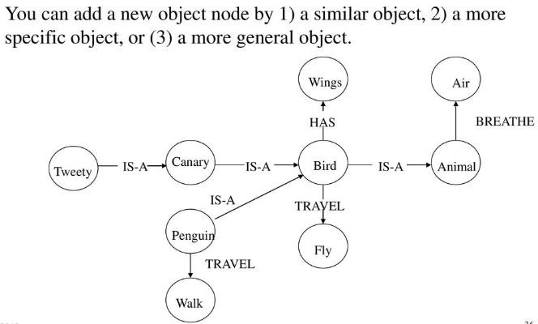
Semantic Networks

Slide 98
Basics of Associative Networks
It's defined as various kinds of links between the concepts.
- “has-part” or aggregation.
- “is-a” or specialization.
- More specialized depending on domain.
It typically also includes Inheritance and some kind of procedural attachment.
Example :
- Tom is a Bird.
- Bird is a Animal.
- Bird has part Wings.

Slide 99

Basics of Associative Networks
Example : Tom is a Bird. Bird is a Animal.
Bird has part Wings.
The ISA (is-a) or AKO (a-kind-of) relation is often used to link instances to classes, classes to super classes
Is-a
Some links (e.g. has Part) are
inherited along ISA paths.
The semantics of a semantic net can be relatively informal or very formal
– often defined at the implementation level
Bird
Animal
has-part
Tom
wings

Slide 100
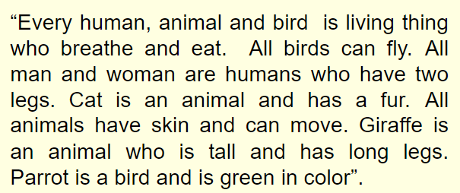
Draw a Semantic Network

Slide 101
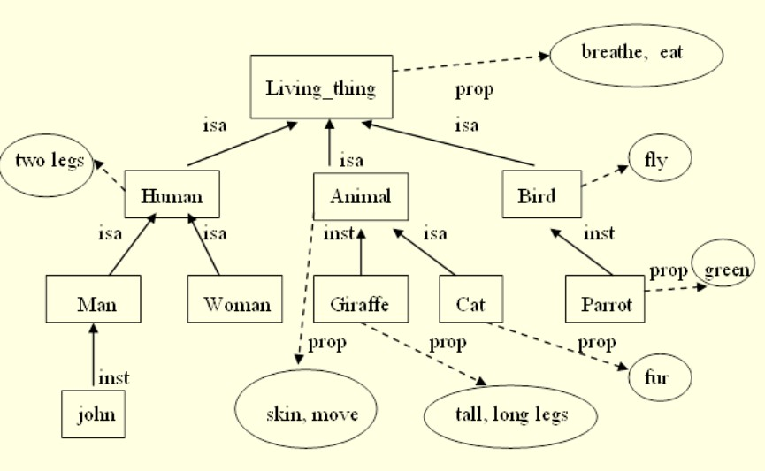
https://www.slideserve.com/kacy/knowledge-representation-techniques

Slide 102
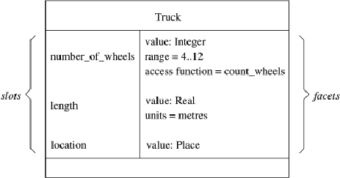
FRAME STRUCTURES
Semantic networks morphed into Frame representation Languages in the ‘70s and ‘80s.
A frame is a lot like the notion of an object in OOP, but has more meta-data.
Represents related knowledge about a subject
A frame has a set of slots.
A slot represents a relation to another frame (or value)
A slot has one or more facets.
A facet represents some aspect of the relation.
Facet : A slot in a frame holds more than a value

Slide 103
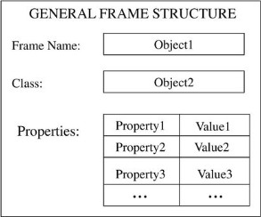
Frame
A data structure for representing stereotypical knowledge of some concept
A frame is a collection of attributes and associated values that describe some entity in the world.
Frames are general record like structures which consist of a collection of slots and slot values.

Slide 104
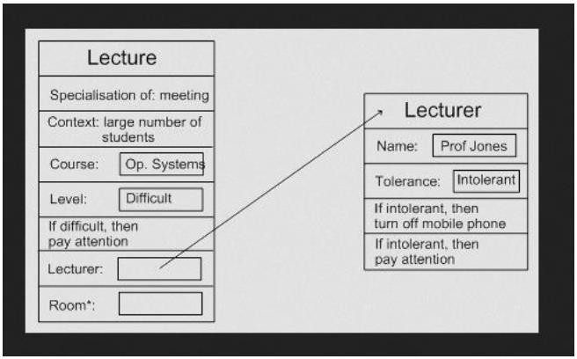
Frame Structures
Example :
(Jones)
(Profession (Value Lecturer))
(Age (Value 25 ))
(City (Value Yelahanka))
(State (Value Karnataka))
* Note : value is a Keyword.

Slide 105
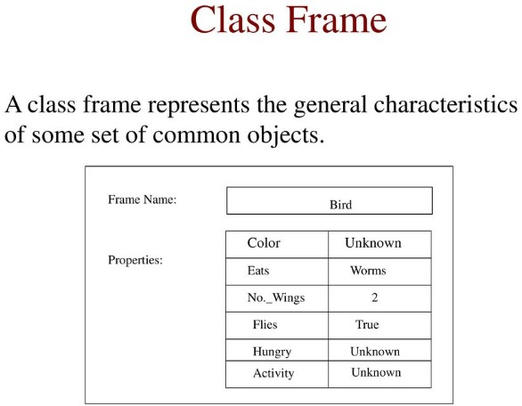

Slide 106
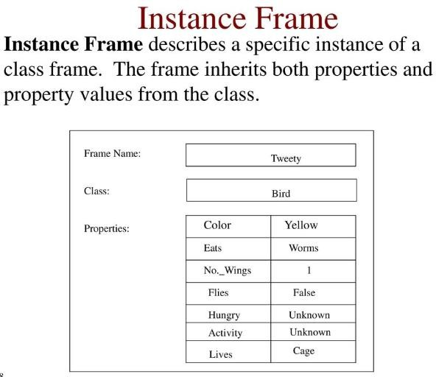

Slide 107
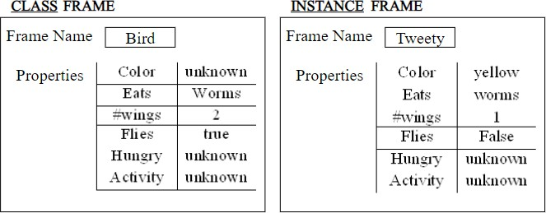
https://slideplayer.com/slide/6072316/

Slide 108
Conceptual Graphs
Semantic Network where each graph represents a single preposition
Consists of basic concepts and the relationship between them
KB consists of set of Conceptual Graphs
It tries to capture the concepts about the events and represents them in the form of a graph.
A concept may be individual or generic.
An individual concept has a type field followed by a reference field.
A single conceptual graph is roughly equivalent to a graphical diagram of a natural language sentence where the words are depicted as concepts and relationships.

Slide 109
Conceptual Graphs
Conceptual graph
A finite, connected, bipartite graph.
No arc labels, instead the conceptual relation nodes represent relations between concepts
Concepts are represented as boxes and conceptual relations as ellipses
Nodes
Concept Nodes – box nodes
– Concrete concepts:
» These concepts are characterized by our ability to form an image of them in our minds.
» cat, telephone, classroom
» Concrete concepts include generic concepts such as cat or book along with concepts of
specific cats and books
– Abstract objects:
» Abstract Concepts that do not correspond to images in our minds
» love, beauty, loyalty
Conceptual Relation Nodes – ellipse nodes
– Relations involving one or more concepts
– Some special relation nodes, namely, agent, recipient, object, experiencer, are used to link a subject and the verb
– Arity – number of box nodes linked to

Slide 110
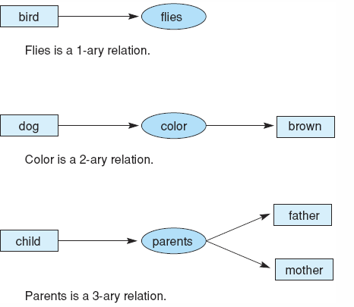
Conceptual Graphs
Example :

Slide 111
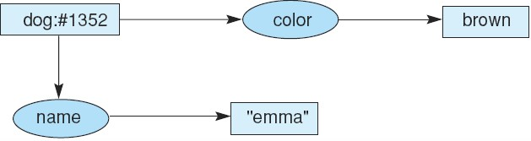
Conceptual Graphs
Example :
Conceptual graph indicating that the dog named Emma is brown.
Conceptual graph indicating that a particular (but unnamed) dog is brown.
Conceptual graph indicating that a dog named Emma is brown.

Slide 112
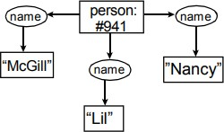
Example: Her name was McGill and she called herself Lil, but everyone knew her as Nancy

Slide 113
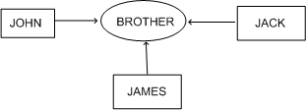
Conceptual Graphs
Example :
Each graph represents a single proposition.
Advantage:
– Single relationship between multiple concepts is easily representable.

Slide 114
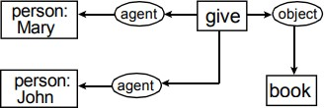
Example: Mary gave John the book

Slide 115
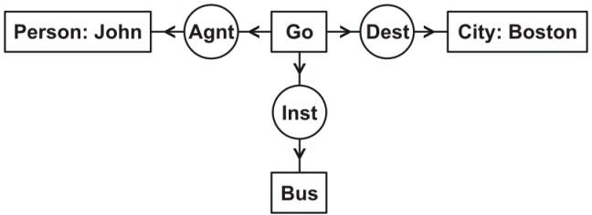
Example: John is going to Boston by bus
Each of the four concepts has a type label, which represents the type of entity the concept refers to: Person, Go, Boston, or Bus.
Two of the concepts have names, which identify the referent: John or Boston.
Each of the three conceptual relations has a type label that represents the type of relation: agent (Agnt), destination (Dest), or instrument (Inst).
The CG as a whole indicates that the person John is the agent of some instance of going, the city Boston is the destination, and a bus is the instrument.

Slide 116
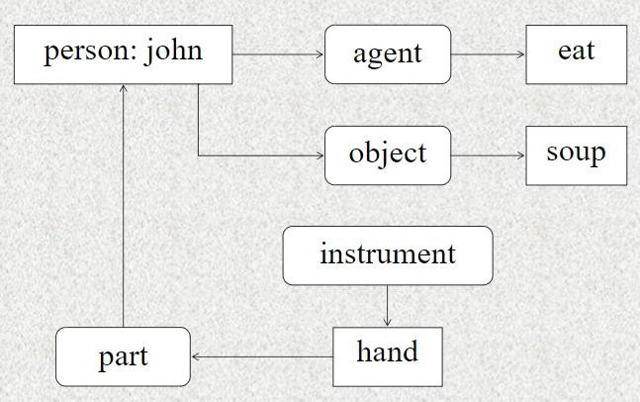
Example: John agent eat object soup instrument hand part

Slide 117
Summary
Graphs are very easy to store inside a computer, by structuring knowledge in a useful fashion
An ontology formally represents concepts in a domain and relationships
between those concepts
The concept originated in philosophy; a model of a theory of nature or existence.
An ontology describes the things we want to talk about, including both
objects and relationships

Slide 118
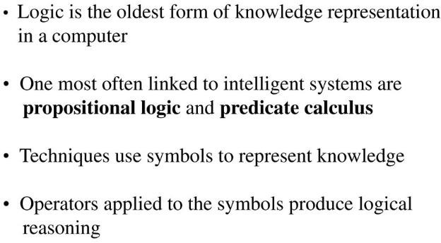
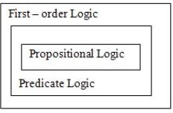
Logic
A logic is a formal language, with precisely defined syntax and semantics, which supports sound inference.
Different logics exist, which allow you to represent different kinds of things, and which allow more or less efficient inference.

Slide 119
Acknowledgement & Disclaimer
The content in the slides is amalgamated from web.
Many websites have been visited and different tutorials have been used
I want to thank my colleagues and students for being so supportive and understanding.
If you find any mistake do point the slide no and point.
Thank you!

